Slide 1
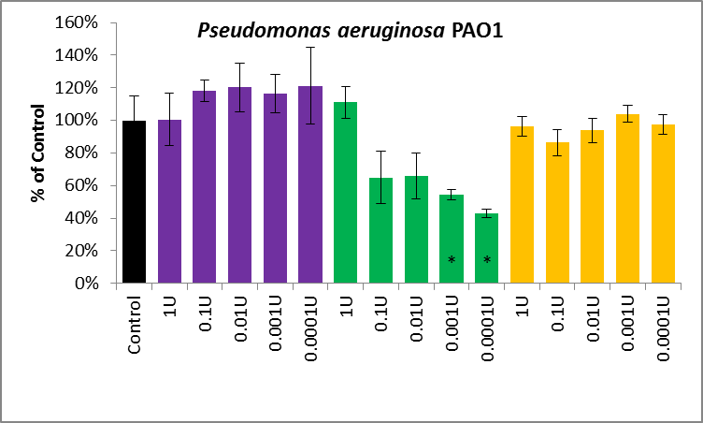
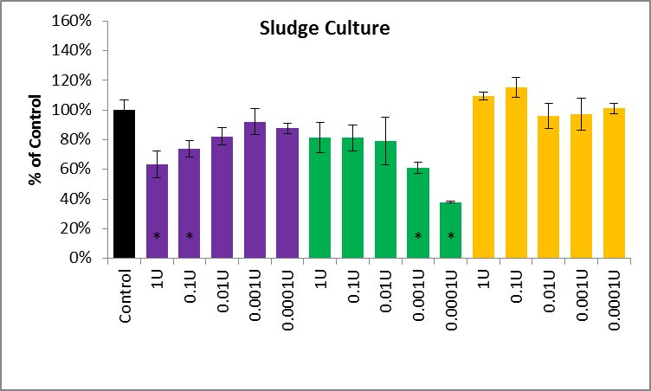
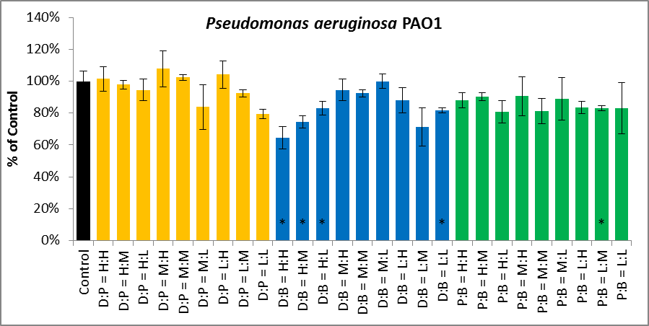
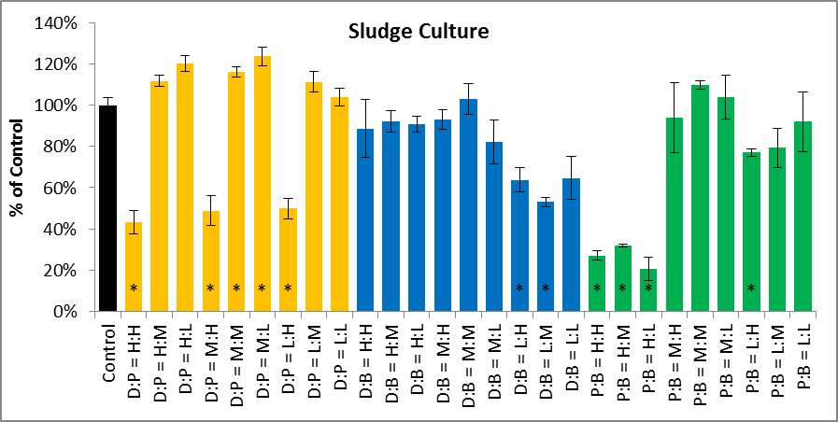
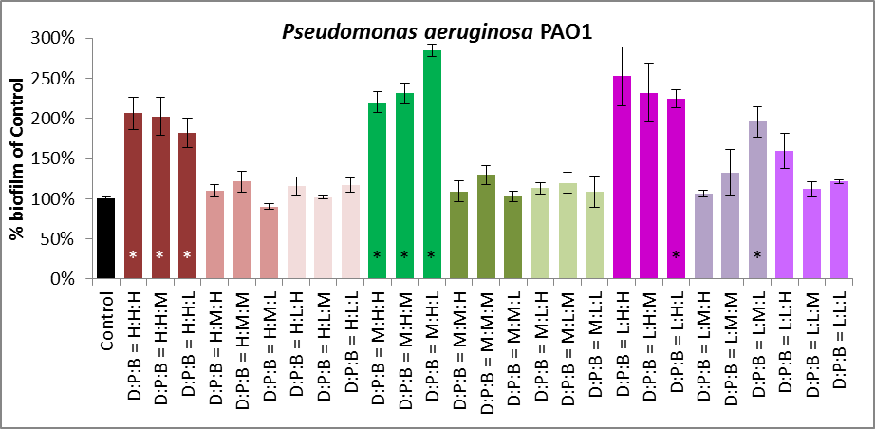
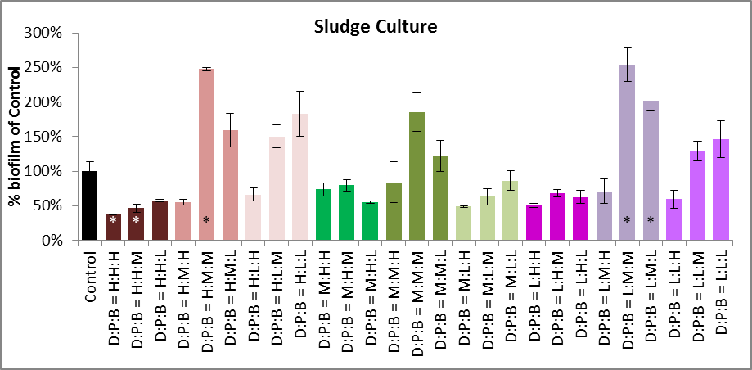
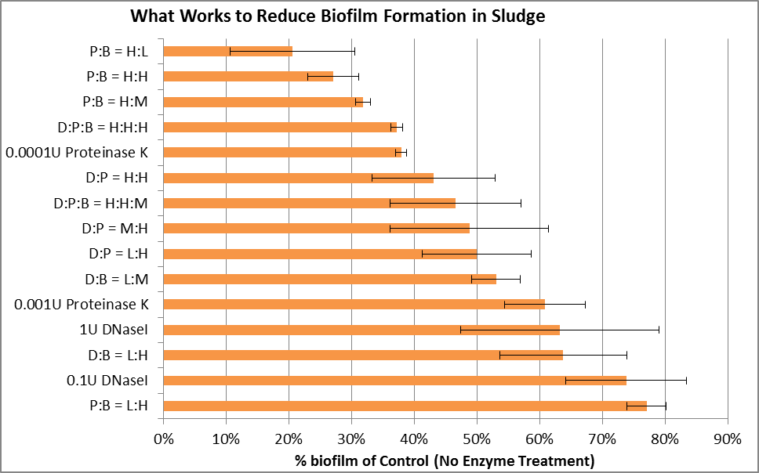
Division of Bioengineering
School of Chemical and Biomedical Engineering
Right Enzyme Concentration is Needed to Reduce Initial Biofilm Formation
Maurice HT Ling¹, Anthony G Fane², Poh Chueh Loo^{1,}*
¹School of Chemical and Biomedical Engineering, Nanyang Technological University
²Singapore Membrane Technology Centre, Nanyang Environment and Water Research Institute
*Corresponding author: Asst/P Poh Chueh Loo (clpoh @ntu.edu.sg)
Abstract
Biofilm can play two opposing roles in an extractive membrane system (EMBR) for bioremediation. Biofilm can be useful in reducing volatilization of organic solvents, such as phenol, but it can also reduce extractive capacity of the membrane. In this project, EMBR is used to extract phenol from industrial waste-water for biodegradation by acclimatized sludge. There had been studies showing potential uses of enzymes in both reducing initial biofilm formation and degrading mature biofilm. In this study, we examine the use of DNase I, Proteinase K, and Dispersin B; singly and in combination; to reducing initial biofilm formation or degrading mature biofilm from sludge. Our results suggests that low concentrations of Proteinase K can reduce initial biofilm formation but high concentrations of Proteinase K may stress the cells and result in no biofilm reduction. Combination treatments have varying results in reducing initial biofilm formation but may also increase biofilm formation.
Hypotheses
Results
Reduction in sludge biofilm formation is proportional to concentration of enzyme
Combination enzyme treatment reduces more biofilm formation compared to single enzyme treatment
Single Enzyme
Methods
DNaseI
Proteinase K
Dispersin B
DNaseI
Proteinase K
Dispersin B
Prepare overnight culture
Inoculate 1:100 O/N culture in M9 + casamino acid + glucose, with varying [enzyme] from 0.0001U/100ul to 1U/100ul
Inoculate triplicates into 96-well plates (100ul per well) and incubate for 24 hours
Wash and air dry plates, stain with 125ul of 0.1% crystal violet, solubilize stain with 30% acetic acid
Shake for 10 minutes and quantify biofilm at 550 nm wavelength
(Control = no enzyme)
Double Enzymes
[H]_{enzyme} = 1 U/100ul [M] _{enzyme} = 0.01 U/100ul [L] _{enzyme} = 0.0001 U/100ul
Triple Enzymes
[H]_{enzyme} = 1 U/100ul [M] _{enzyme} = 0.01 U/100ul [L] _{enzyme} = 0.0001 U/100ul
Conclusion
High [proteinase K] with dispersin B reduces biofilm formation but not economically feasible (requires 10,000 U/L of proteinase K)
Low concentration of proteinase K is economically feasible (requires only 1 U/L)
Increased [enzyme] may not result in proportional reduction in biofilm formation – it may increase biofilm formation (DNase I)
Combination enzyme treatment may increase biofilm formation and this might be due to cell stress
www.ntu.edu.sg

